Slide 1
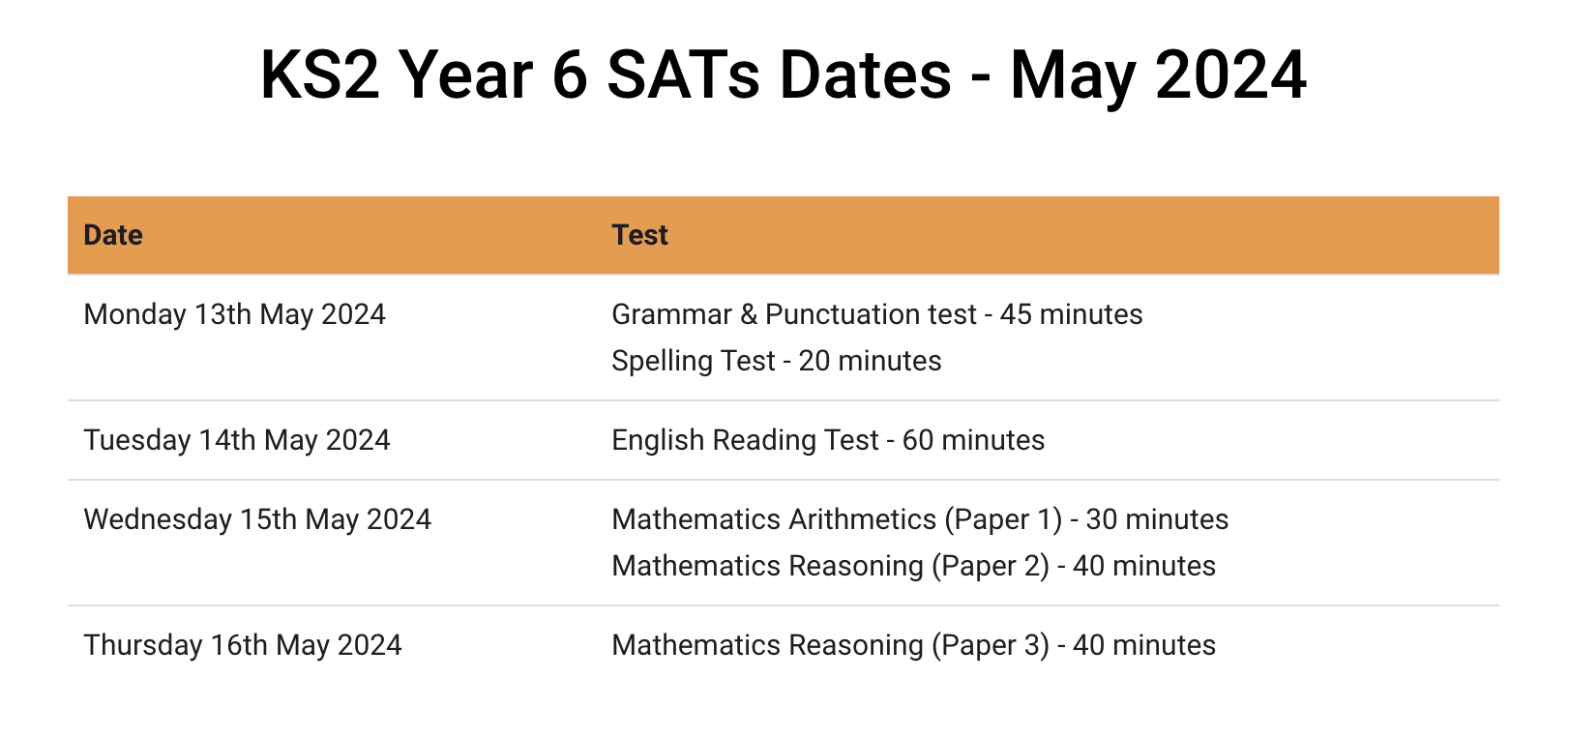
Key Stage 2 SATs Meeting

Slide 2
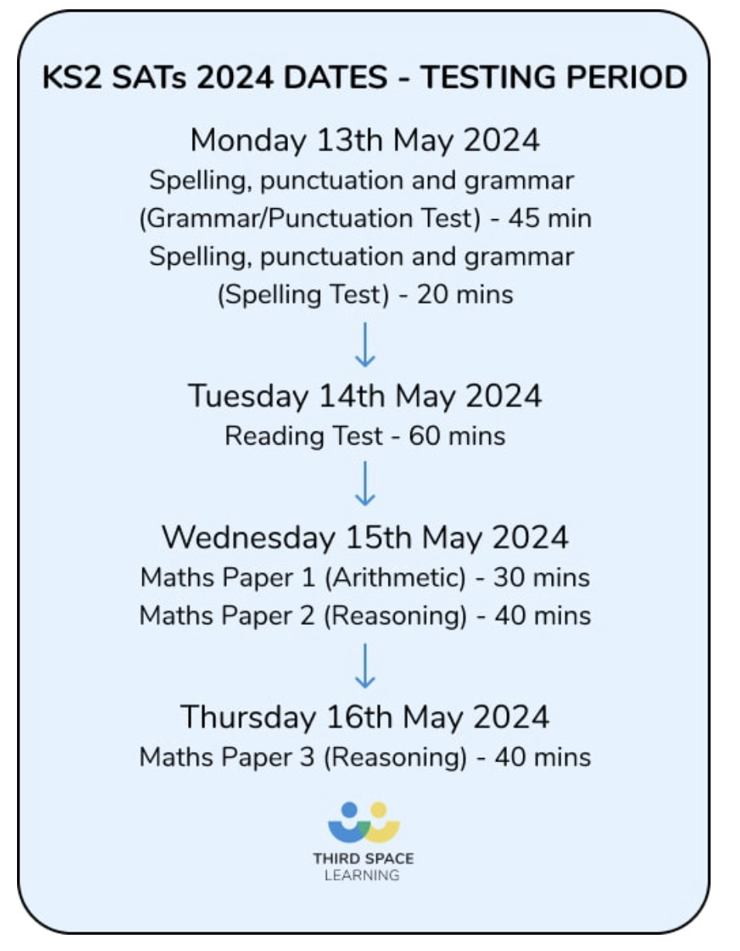
What are the SATs?
SATs are the Standardised Assessment Tests that are given to children at the end of Key Stage 2.
*Writing is assessed using evidence collected throughout Year 6. There is no Year 6 SATs writing test.*

Slide 3
When and how the SATs are completed?
The tests take place during normal school hours, under exam conditions.
Children are not allowed to talk to each other from the moment the assessments are handed out until they are collected at the end of the test.
After the tests are completed, the papers are sent away to be marked externally.
The results are then sent to the school in July.
Each test lasts no longer than 60 minutes:
Spelling, punctuation and grammar Grammar/ Punctuation – 45 minutes
Spelling, punctuation and grammar Spelling – 15 minutes
Reading – 60 minutes
Maths (paper 1: Arithmetic) – 30 minutes
Maths (paper 2: Reasoning) – 40 minutes
Maths (paper 3: Reasoning) – 40 minutes

Slide 4
Specific arrangements for SATs
Children with additional needs (who have similar support as part of day-to-day learning in school) may be allotted specific arrangements, including:
Additional (extra) time;
Tests being opened early to be modified;
An adult to scribe (write) for them;
Using word processors independently;
An adult to read for them (including a translator);
The use of prompts or rest breaks;
Arrangements for children who are ill or injured at the time of the tests.

Slide 5
The Results
Tests are marked externally. Once marked, the tests will be given the following scores:
A raw score (total number of marks achieved for each paper);
A scaled score (see below);
A judgement on if the National Standard has been met.
After marking each test, the external marker will convert the raw score to a scaled score.
Even though the tests are made to the same standard each year, the questions must be different. This means the difficulty of the tests may vary.
Scaled scores ensures an accurate comparison of performance over time.
Scaled scores range from 80 to 120.
A scaled score of 100 or more shows the pupil is meeting the National Standard.

Slide 6
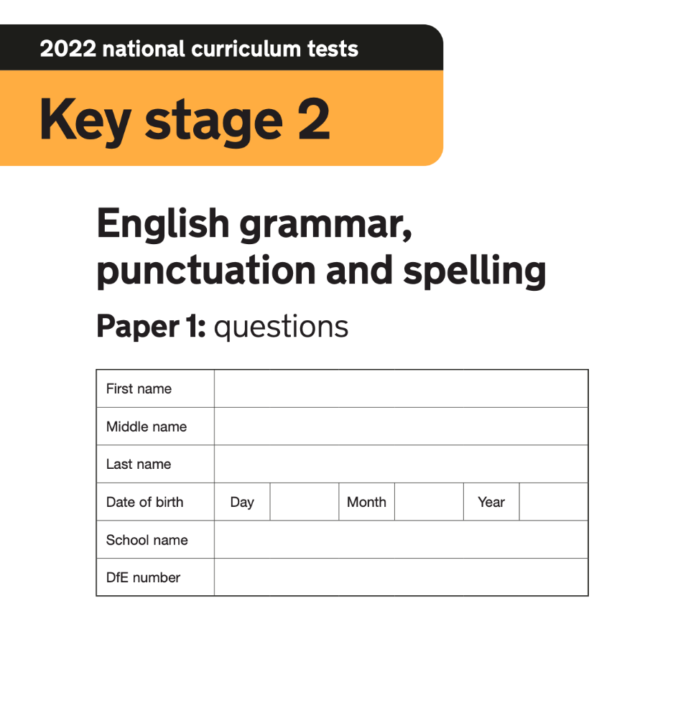
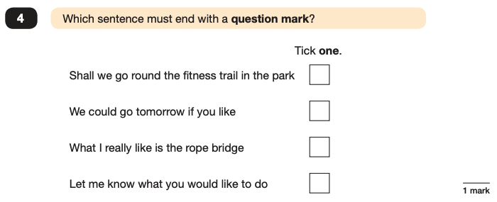
Grammar, Punctuation and Spelling: Monday 13th May
Grammar, punctuation and spelling consists of two papers.
This test focuses on:
Grammatical terms/ word classes;
Functions of sentences;
Combining words, phrases and clauses;
Verb forms, tenses and consistency;
Punctuation;
Vocabulary;
Standard English and formality.
Paper 1 focuses on all three elements (grammar, punctuation and spelling or GPS). The paper lasts for 45 minutes.

Slide 7
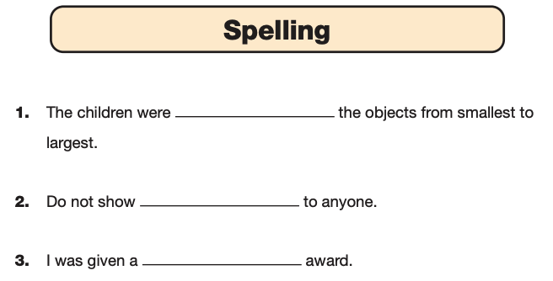
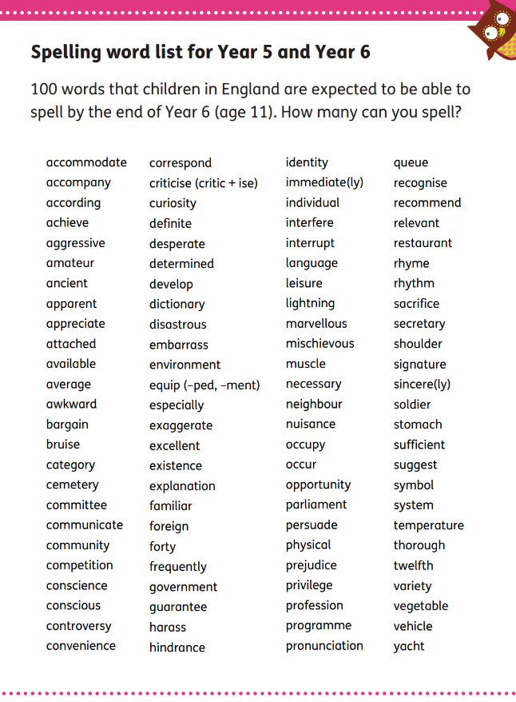
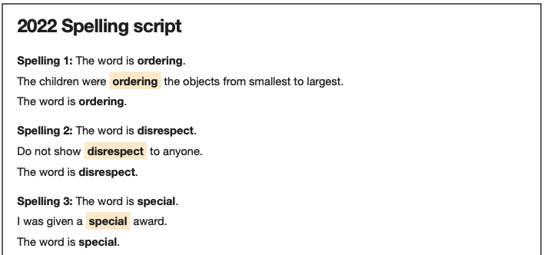
Grammar, Punctuation and Spelling: Paper 2 Spelling
Paper 2 consists of a spelling test only. It should take approximately 15 minutes, although this is not a set amount of time (pupils should be given as much time as they need to complete the test).

Slide 8
Reading: Tuesday 14th May
There is one reading test that lasts for 60 minutes.
The test is designed to measure if the children’s comprehension of age-appropriate reading material meets the national standard. There are three different set texts for children to read. These could be any combination of non-fiction, fiction and/ or poetry.
The test covers the following areas (known as Content Domains):
Give/ explain the meaning of words in context;
Retrieve and record information/ identify key details from fiction and non-fiction;
Summarise main ideas from more than one paragraph;
Make inferences from the text/ explain and justify inferences with evidence from the text;
Predict what might happen from details stated and implied;
Identify/ explain how information/ narrative content is related and contributes to meaning as a whole;
Identify/ explain how meaning is enhanced through choice of words and phrases;
Make comparisons within the text.

Slide 9
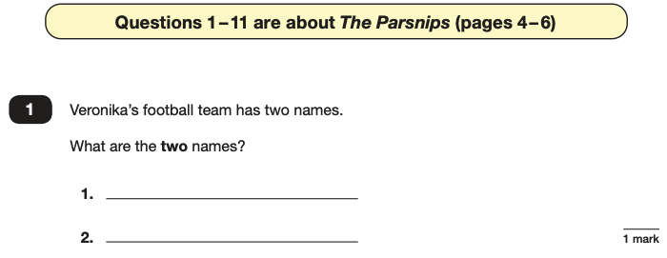
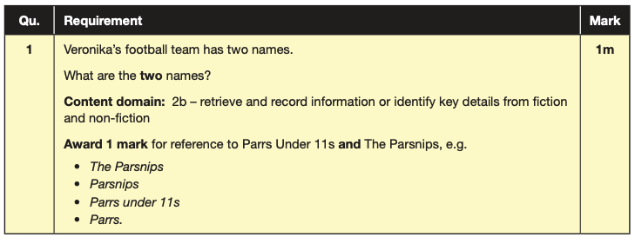
Reading
The reading SATs paper requires a range of answer styles.
Example questions:

Slide 10
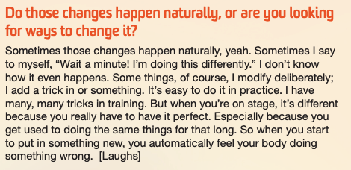

Slide 11
Reading
Since the current testing formation for the SATs began in 2016, there has been a tendency for three types of questions to be the most popular.
In the 2022 Reading SATs paper,
10% of marks could be gained from answering questions involving giving and explaining the meaning of words in context;
38% of marks could be gained from answering questions involving retrieving and recording information or identifying key details from a text;
44% of marks could be gained from answering questions involving making inferences from a text and justifying inferences with text evidence.
When reading with your child at home try focusing on these types of questions.

Slide 12
Maths Assessments

Slide 13
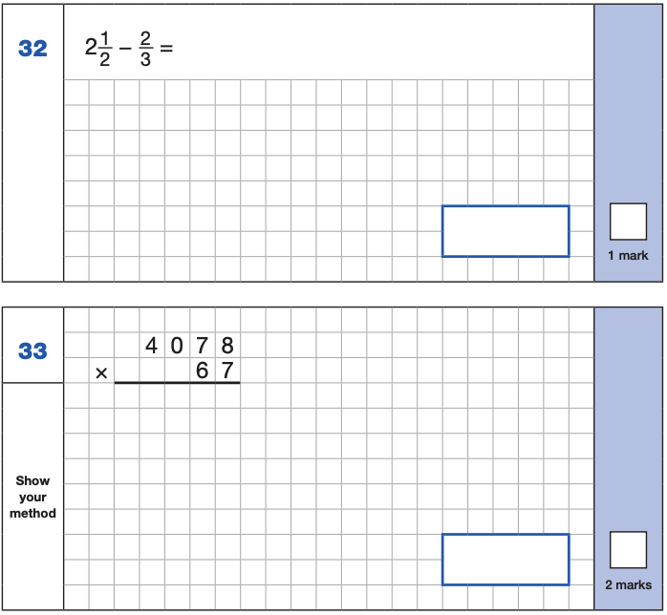
Maths Paper 1 (Arithmetic)
The maths arithmetic paper has a total of 40 marks and lasts for 30 minutes.
The test covers the four operations (addition, subtraction, multiplication, division, including order of operations requiring BIDMAS), percentages of amounts and calculating with decimals and fractions.
Example questions:

Slide 14
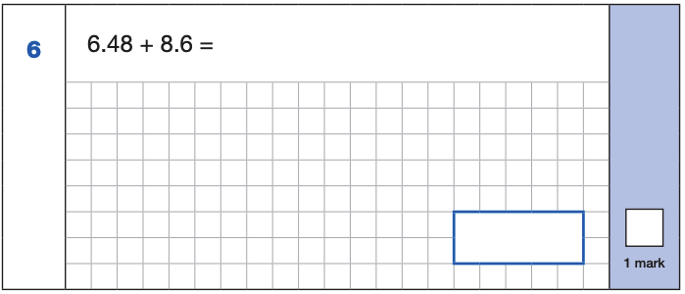
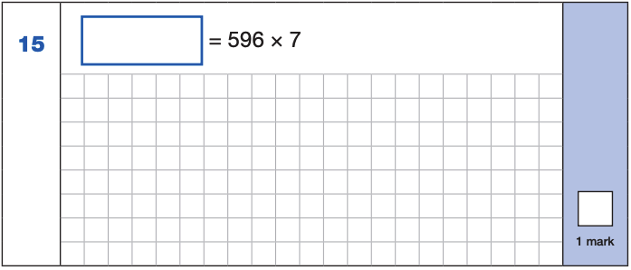
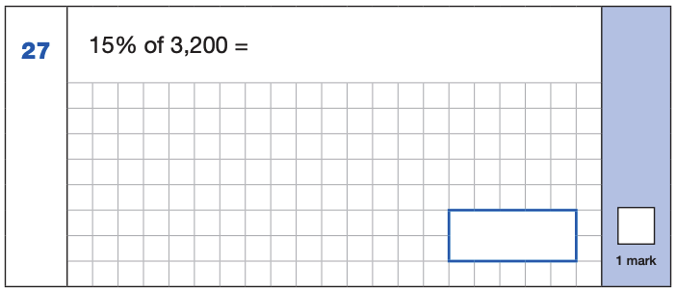
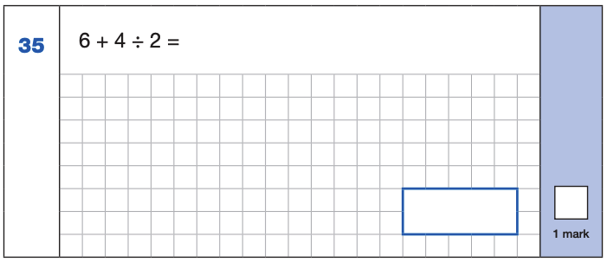
Maths Paper 1 (Arithmetic)
Example 1-mark questions:
4,172
6.48
+ 8.6 .
15.08
¹
596
x 7
4172
⁶ ⁴
15.08
4 ÷ 2 = 2
6 + 2 = 8
10% of 3,200 = 320
5% of 3,200 = 160
15% of 3,200 = 480
480

Slide 15
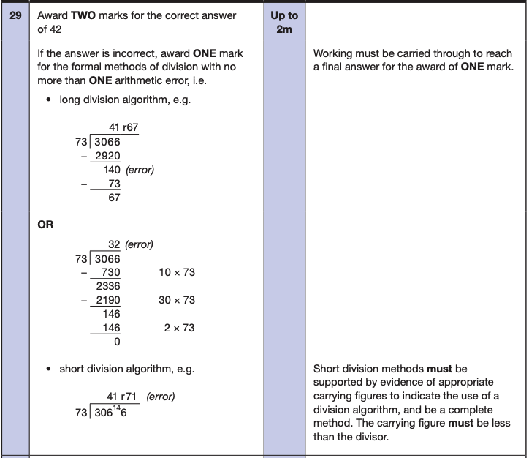
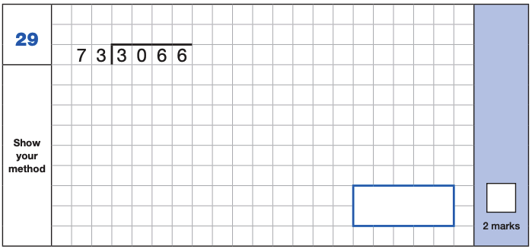
Maths Paper 1 (Arithmetic)
Example 2 mark question:

Slide 16
Maths Papers 2 and 3 (Reasoning)
Paper 2 will take place on Wednesday 15th May and paper 3 will take place on Thursday 16th May.
These tests have a total of 35 marks each and lasts for 40 minutes each.
These papers require children to demonstrate their mathematical knowledge and skills, as well as their ability to solve problems and their mathematical reasoning. They cover a wide range of mathematical topics from key stage 2 including,
Number and place value (including Roman numerals);
The four operations;
Geometry (properties of shape, position and direction);
Statistics;
Measurement (length, perimeter, mass, volume, time, money);
Algebra;
Ratio and proportion;
Fractions, decimals and percentages.

Slide 17
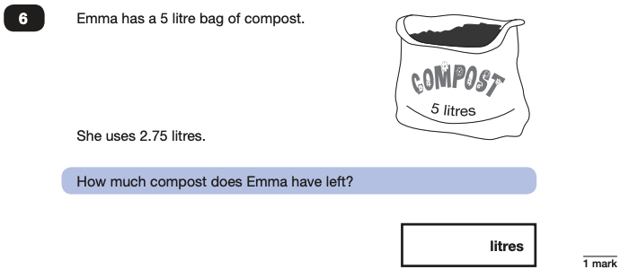
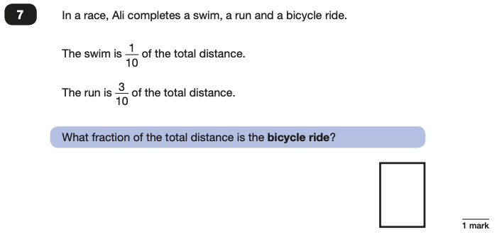
Maths Papers 2 (Reasoning)
Example questions:
2.25
$$\frac{\text{6}}{\text{10}}$$

Slide 18
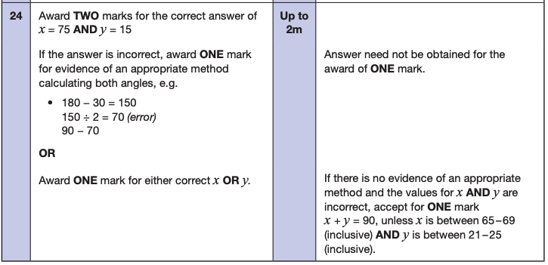
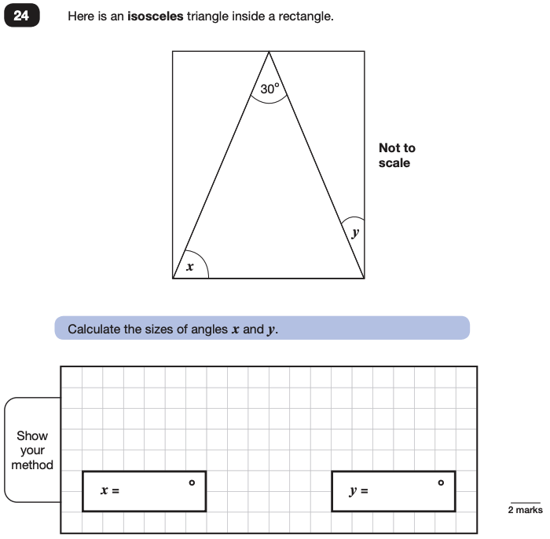
Maths Papers 2 (Reasoning)
Example question:

Slide 19
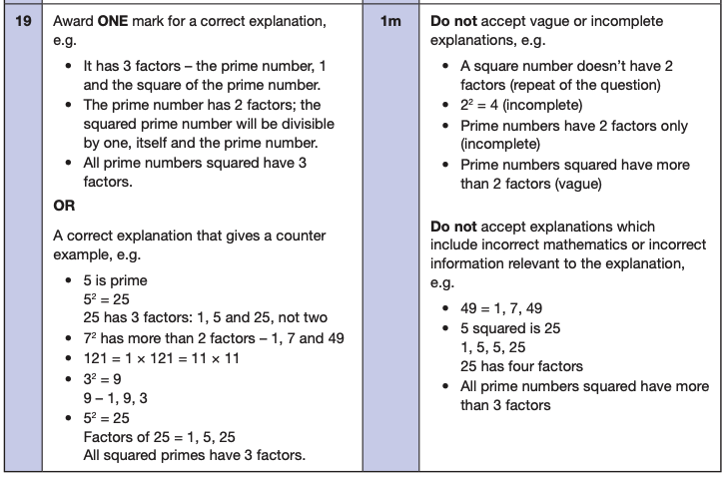
Maths Papers 3 (Reasoning)
Example questions:

Slide 20
SATs Week in School
Early Breakfast Club everyday – come in early and have a great breakfast provided for free and some extra time with the teachers before the tests.
Early nights and healthy brain food.
Monday – Thursday Tests
Friday Fun

Slide 21
Supporting your child in preparing for the SATs
Tips:
Talk to your child’s class teacher if you have any concerns rather than worry your child.
Encourage your child to talk to their teacher or a trusted adult (including yourself) about their anxieties. Don’t forget that a small amount of anxiety is normal and not harmful.
Give your child a quiet, distraction free space to complete homework or study.
Give your child time to go outside and reduce screen time.
Ensure your child is eating and drinking well and getting a good amount of sleep.
Plan something nice and fun for the weekends before and after SATs. This will help them to relax before the SATs and give them something to look forward to after.

Slide 22
Things to remember about SATs
SATs focus on what children know about Maths and English.
They will not reflect how talented they are at science, geography, art, PE…, and they certainly won’t highlight all of their amazing personal characteristics.
SATs don’t tell the whole story.
Their results will say if they did or did not meet a certain standard but not necessarily by what margin. These thresholds change each year according to the overall national performance, so what was classed as ‘meeting the expected standard’ this year might not be the same as last year. Your school may be able to provide you with more detailed feedback.
SATs are only four days out of a whole Primary School career.
In reality, there’s one or two papers each day that last 30 to 60 minutes.

Slide 23
Advice for Year 6 children
Listen to your teacher.
The adults you work with all want you to do your best.
Get plenty of sleep and eat well, this will help your brain.
Read all the questions carefully. This can help you to avoid silly mistakes.
Don’t panic. There may be questions you think you can’t answer. Take a deep breath. Read it again. You can always move on and go back to it later. It’s often better to write something rather than nothing.
Remember that the Year 6 SATs last for 4 days out of your whole life!

