Slide 1
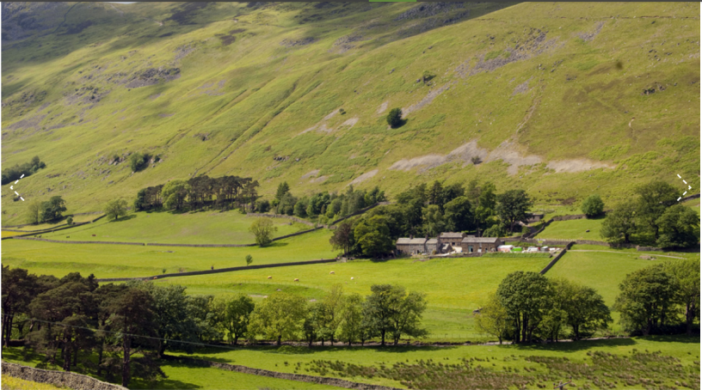
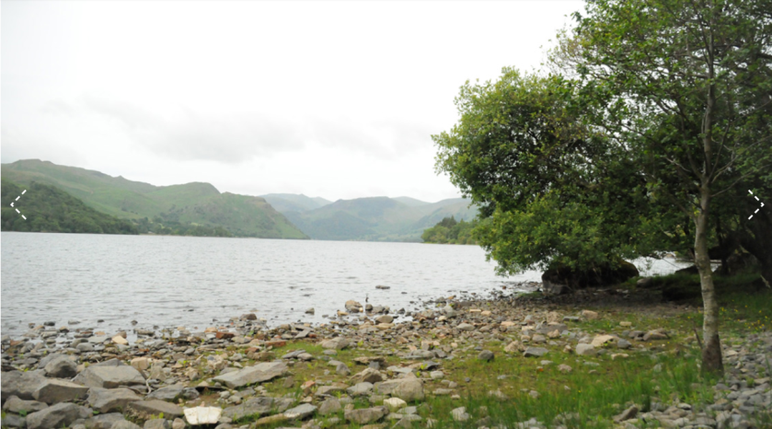
Outward Bound Residential 18^{th -} 22^{nd March} 2024

Slide 2
https://www.outwardbound.org.uk/centres/ullswater/
The Ullswater centre accommodates 120 people in bunk rooms of 4-10 people. Some rooms have en-suite bathrooms and others have toilets and showers adjacent to rooms.
The Outward Bound Trust Ullswater Centre, Watermillock, Penrith, Cumbria CA11 0JL T: 01768 485000

Slide 3
Sample Menu

Slide 4
Kit List
CLOTHING (Please note this is only an idea of what is required, do not buy things specifically for the trip) All waterproofs, walking boots, wellingtons etc. are provided
Casual t-shirts *Toiletries such as shower gel, shampoo,
- Sweatshirts deodorant, toothbrush, toothpaste
- Thermal tops NO SPRAYS/AEROSOLS
- Jumpers * prescribed medication - school need this
- Fleece tops handing in not in cases
-Warm coat -hairbrush,comb,bobbles
- Thick and thin socks
-Tracksuit bottoms or joggers for walking (not jeans)
- Jeans/trousers/leggings (for around the centre only)
- 2 pairs of trainers (one which can get wet)
- Underwear
- Pyjamas
- Shorts
Swimming costume/trunks
- Hat and gloves
- Towel
- All courses will involve getting wet at some point, so please make sure your child has plenty of spare, dry clothes to change into.

Slide 5
More information
The centre will supply: waterproofs, wellingtons and activity specific equipment
Your child can bring £5.00 spending money
No mobile phones
Please do not send crisps, biscuits and sweets the cook will cater even for the fussiest of eaters!

Slide 6
Travel Arrangements
Monday 18th March- Setting off, by coach from school at 11.00am
Your child will need to bring a packed lunch for Monday unless they usually have a school dinner
Friday 22nd March returning at about 3.00pm
(We will keep you updated on the time of arrival back at school via social media and Class Dojo)

Slide 7
Any questions?

